Slide 1
Chapter 4

Slide 2
Outline
Distributed Algorithm
1- Ricart and Agrawala's algorithm
2- Token Ring Algorithm:
ELECTION ALGORITHMS
1- The Bully Algorithm
2- Ring Algorithm:
3- Elections in Wireless Environments
Elections in Large-Scale Systems

Slide 3
A Distributed Algorithm
2
Distributed Algorithm: is an algorithm that runs on a distributed system. Distributed system is a collection of independent computers that have their local memories. Each processor has its own memory and they communicate via communication networks.

Slide 4
1- Ricart and Agrawala's algorithm
The algorithm works as follows:
When a process wants to access a shared resource, it builds a message containing the name of the resource, its process number, and the current timestamp. It then sends the message to all other processes, conceptually including itself.
The sending of messages is assumed to be reliable; that is, no message is lost.

Slide 5
When a process receives a request message from another process, the action it takes depends on its own state with respect to the resource named in the message. Three different cases have to be clearly distinguished:
If the receiver is not accessing the resource and does not want to access it, it sends back an OK message to the sender.
If the receiver already has access to the resource, it simply does not reply. Instead, it queues the request.
If the receiver wants to access the resource as well but has not yet done so, it compares the timestamp of the incoming message with me. one contained in the message that it has sent everyone. The lowest one wins. If the incoming message has a lower timestamp, the receiver sends back an OK message.
After sending out requests asking permission, a process sits back and waits until everyone else has given permission. As soon as all the permissions are in, it may go ahead. When it is finished, it sends OK messages to all processes on its queue and deletes them all from the queue.

Slide 6
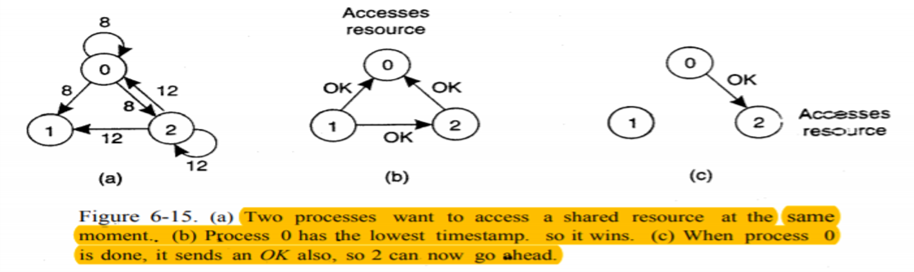
1- Ricart and Agrawala's algorithm :
2
When process 0 wants to access a resource:
In Figure 6-15 (a), every node receives a request from process 0 with a timestamp of 8, and everyone receives a request from process 2 with a timestamp of 12.
In Figure 6-15 (b), process 1 sends OK to both senders because it is not interested in the resource. The conflict is visible and the timestamps are compared by processes 0 and 2. Process 2 realizes it has greater timestamp, so it sends OK to give permission to process 0.
In Figure 6-15 (c), process 0 now accesses the resources and it queues the request from process 2, after it finishes the use of resources, it sends an OK message to process 2 and removes the request from its queue, enabling process 2 to continue.

Slide 7

2. Token Ring Algorithm:
a logical ring is constructed in which each process is assigned a position in the ring, as shown in Fig. 6-16(b). The ring positions may be allocated in numerical order of network addresses or some other means. It does not matter what the ordering is. All that matters is that each process knows who is next in line after itself

Slide 8
When the ring is initialized, process 0 is given a token. The token circulates around the ring. It is passed from process k to process k +1 (modulo the ring size) in point-to-point messages. When a process acquires the token from its neighbor, it checks to see if it needs to access the shared resource. If so, the process goes ahead, does all the work it needs to, and releases the resources. After it has finished, it passes the token along the ring.
If a process is handed the token by its neighbor and is not interested in the resource, it just passes the token along. As a consequence, when no processes need the resource, the token just circulates at high speed around the ring.

Slide 9
- ELECTION ALGORITHMS:
If all processes are exactly the same, with no distinguishing characteristics, there is no way to select one of them to be special -.Consequently, we will assume that each process has a unique number, for example, its network address (for simplicity, we will assume one process per machine).
In general, election algorithms attempt to locate the process with the highest process number and designate it as coordinator. The algorithms differ in the way they do the location.

Slide 10
1- The Bully Algorithm:
When any process notices that the coordinator is no longer responding to requests, it initiates an election. A process, P, holds an election as follows:
P sends an ELECTION message to all processes with higher numbers.
If no one responds, P wins the election and becomes coordinator.
If one of the higher-ups answers, it takes over. P's job is done

Slide 11
a process can get an ELECTION message from one of its lower-numbered colleagues. When such a message arrives, the receiver sends an OK message back to the sender to indicate that he is alive and will take over. The receiver then holds an election, unless it is already holding one. Eventually, all processes give up but one, and that one is the new coordinator. It announces its victory by sending all processes a message telling them that starting immediately it is the new coordinator.
If a process that was previously down comes back up, it holds an election. If it happens to be the highest-numbered process currently running, it will win the election and take over the coordinator's job.

Slide 12
(Self Study) example of how the bully algorithm works:
The group consists of eight processes, numbered from 0 to 7. Previously process 7 was the coordinator, but it has just crashed. Process 4 is the first one to notice this, so it sends ELECTION messages to all the processes higher than it, namely 5, 6, and 7. as shown in Fig. 6-20(a). Processes 5 and 6 both respond with OK

Slide 13
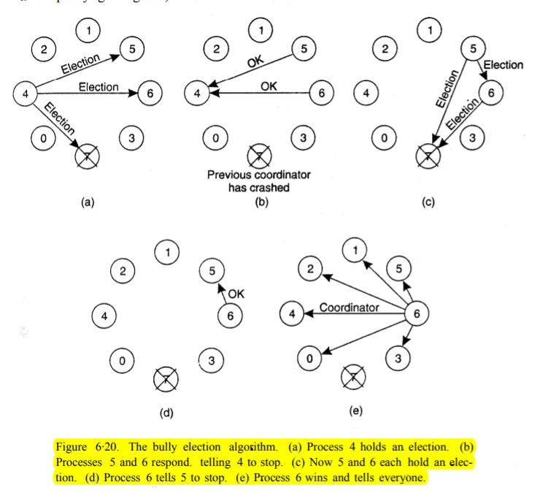
Upon getting the first of these responses, 4 knows that its job is over. It knows that one of these bigwigs will take over and become coordinator. It just sits back and waits to see who the winner will be

Slide 14
2- Ring Algorithm:
. When any process notices that the coordinator is not functioning, it builds an ELECTION message containing its own process number and sends the message to' its successor. If the successor is down, the sender skips over the successor and goes to the next member along the ring. or the one after that, until a running process is located. At each step along the way, the sender adds its own process number to the list in the message effectively making itself a candidate to be elected as coordinator.
Eventually, the message gets back to the process that started it all. That process recognizes this event when it receives an incoming message containing its own process number. At that point, the message type is changed to COORDINATOR and circulated once again.

Slide 15

we see what happens if two processes, 2 and 5, discover simultaneously that the previous coordinator, process 7, has crashed. Each of these builds an ELECTION message and and each of them starts circulating its message, independent of the other one. Eventually, both messages will go all the way around, and both 2 and 5 will convert them into COORDINATOR messages,

Slide 16
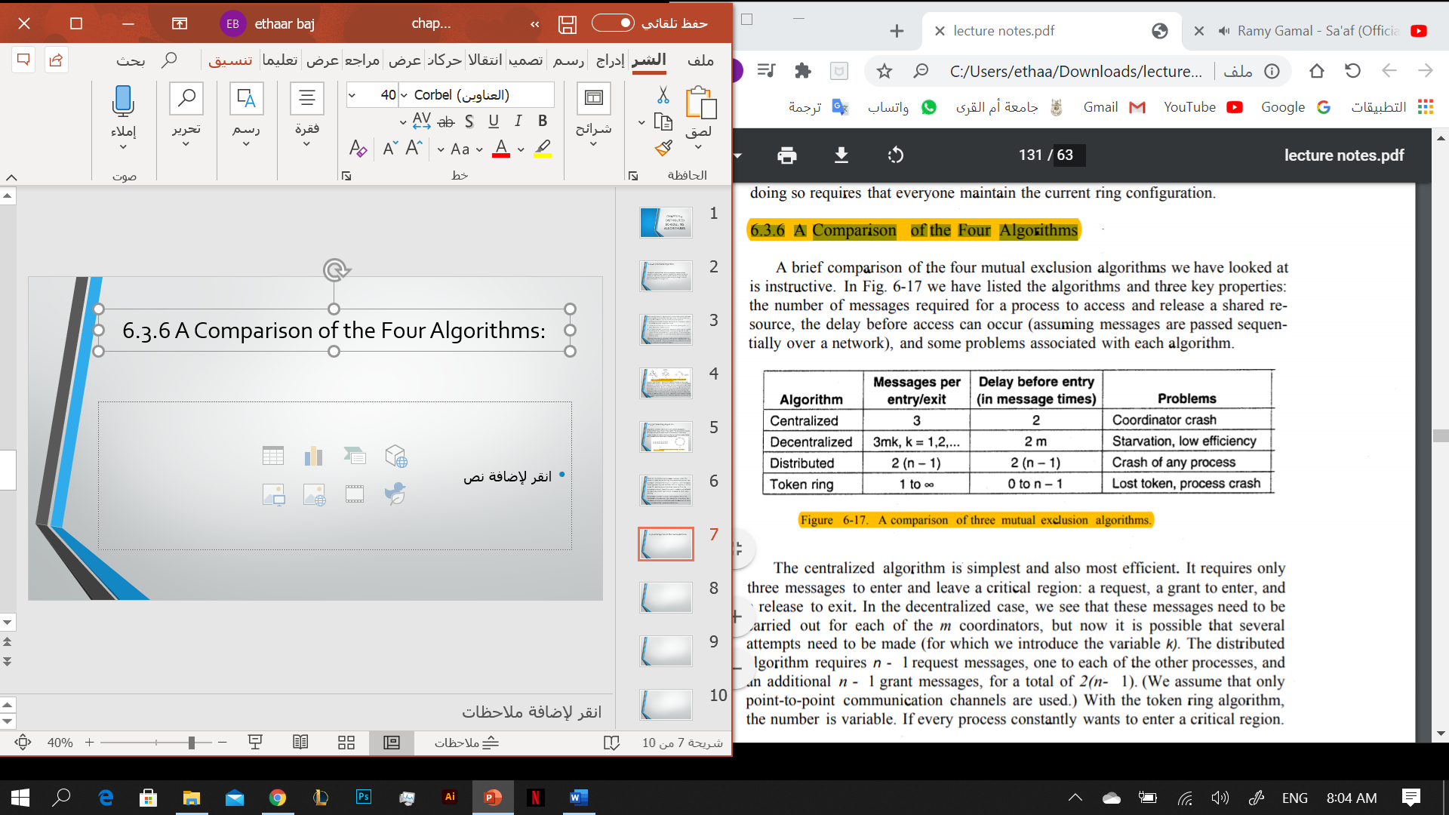
A Comparison of the Four Algorithms:

Slide 17
(Self Study) 3- Elections in Wireless Environments:
Traditional election algorithms are generally based on assumptions that are not realistic in wireless environments. For example, they assume that message passing is reliable and that the topology of the network does not change. These assumptions are false in most wireless environments, especially those for mobile ad hoc networks.
Only few protocols for elections have been developed that work in ad hoc networks. Vasudevan et al. (2004) propose a solution that can handle failing nodes and partitioning networks. An important property of their solution is that the best leader can be elected rather than just a random as was more or less the case in the previously discussed solutions.

Slide 18
(Self Study) 4- Elections in Large-Scale Systems:
Requirements that need to be met for superpeer selection:
Normal nodes should have low-latency access to superpeers.
Superpeers should be evenly distributed across the overlay network.
There should be a predefined portion of superpeers relative to the total number of nodes in the overlay network.
Each superpeer should not need to serve more than a fixed number of normal nodes.

